Slide 1

Salary Class prediction of an individual By sharik sharif baig

Slide 2
PROBLEM statement
Based on an individual's qualifications such as education level, age, gender, experience, occupation, etc., it is difficult to predict if the person's salary is over $50,000 or under $50,000. We shall be using the Naive Bayes method, Linear Regression and Logistic Regression to predict the salaried class

Slide 3
goal
Build a model to predict the salary bracket of an individual.
Apply analytics to find the factors that effects individual’s salary
Provide Accuracy and the Precision of built model

Slide 4
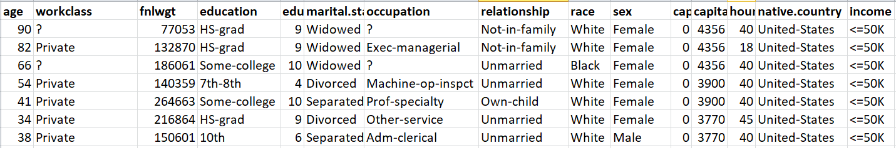
Available insights

Slide 5
algorithm
Analyse the Data
Data Clean-up
Data Preparation
Apply Regression
Build Model
Test Model
Predict
Evaluate
Summarize

Slide 6
ACCURACY of the MODEL
 | False | True
<=50K | 4510 | 104
>50K | 954 | 576
Accuracy = (Correct predictions) / (Total predictions)
= (4510+576) / (4510+104+954+576)
= 5086 / 6144
=0.8277
The accuracy of our model is 82.77%

Slide 7
Conclusion
The study suggests that an individual with a salary exceeding $50,000 is male, has higher education than a master's degree, works more than 40 hours per week, and is employed by a private company.

